Slide 1
DERMATOPHYTOSIS (Ringworm)
Assist. Prof. Dr. Hussein ALNaji

Slide 2
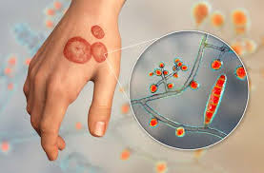
Ringworm is a skin and scalp disease caused by fungi. It gets its name from the characteristic itchy, red ring-like rash on the skin. Approximately 40 different species of fungi can cause ringworm. The different types of ringworm are usually named for the location of the infection on the body. SPECIES: Many species of wild and domesticated animals can get ringworm, including dogs, cats, cattle, sheep, goats, pigs, rodents, rabbits, and birds.

Slide 3
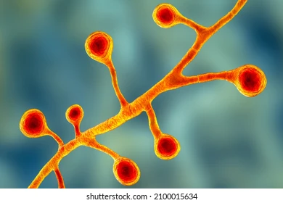
CAUSATIVE AGENT:
Organisms are subclassified into:
Geophilic - inhabit soil
Zoophilic - parasitic on animals
Anthropophilic -primarily infects humans.
All can produce disease in humans. The three types of fungi that cause ringworm are Trichophyton, Microsporum, and Epidermophyton.

Slide 4
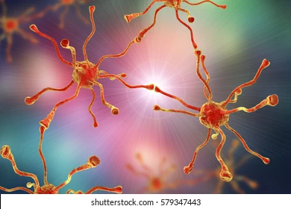
Transmission and spread
1- Ringworm can spread by contact with objects or surfaces that an infectedperson or animal.
2- In rare cases, ringworm can be spread to humans by contact with infected soil or from fungi in air, dust, (spores persist on contaminated surfaces).
DISEASE IN ANIMALS:
1- Disease in rodents is often asymptomatic and not recognized until people are affected.
2- Infected cats are often asymptomatic. Dogs often show classic skin lesions.
3- Ringworm is also fairly common in show lambs and is referred to as “club lamb fungus.” Lambs usually have circular, hairless areas with thick scabs on their head and face

Slide 5
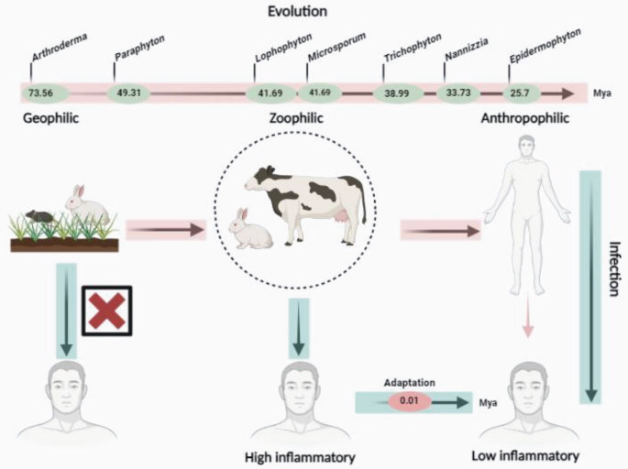

Slide 6
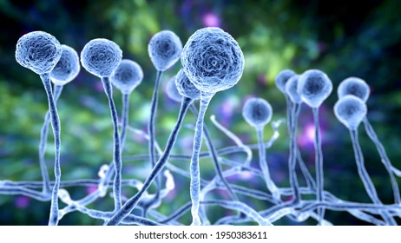
DISEASE IN HUMANS:
1- Ringworm in humans is often mild and self-limiting.
2. Symptoms of ringworm often depend on which part of the body is infected, but infected individuals typically develop itchy skin or scalp four to fourteen days after contact. If they develop a rash, it may bescaly, reddened, and circular. Ringworm on the scalp usually makes a bald patch of scaly skinand can result in hair loss.

Slide 7
Diagnostic testing
1- POTASSIUM HYDROXIDE PREPARATION: Clinicians can use a potassium hydroxide (KOH) preparation of skin scrapings or nail clippings to confirm a diagnosis of ringworm.
2- FUNGAL CULTURE: Fungal culture can be used to diagnose ringworm. Fungal culture is more specific than KOH stain, but results may take several weeks.3,4
3- Histopathologic Examination With A Periodic Acid-schiff Stain
4- Polymerase Chain Reaction (Pcr)
5- Ultraviolet Light (Wood’s Lamp)
Ultraviolet light can be useful for diagnosing ringworm caused by Microsporum canis and Microsporum audouinii. Although both species fluoresce blue-green under a Wood’s lamp, these species are uncommon causes of ringworm infections in people.

Slide 8
Prevention
1- Wash your hands with soap and running water after playing with or petting your pet.
2-Wear gloves and long sleeves if you must handle animals with ringworm, and always wash your hands after handling the animal.
3- Vacuum the areas of the home that the infected pet commonly visits. This will help to remove infected fur or flakes of skin.
4- Disinfect areas the pet has spent time in, including surfaces and bedding.
A- The spores of this fungus can be killed with common disinfectants like chlorine bleach diluted 1:10 (1/4 cup in 1 gallon of water), benzalkonium chloride, or strong detergents.
Never mix cleaning products. This may cause harmful gases.

Slide 9
Thank you

